Slide 1

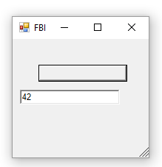

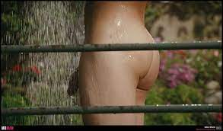
FBI
partner
development
FBI:WHITE:COLOAR
FBI:KIDNAPPIGN
FBI:MISSING PERSONS
TECHNOLOGY
Guy defines PINK nakced se and city shower
ith jack teller in mothech gay porn
At homelles peron house.
10:35
POLCIE SIRENS
Jax-ws
[x] no
Axis2
10:38 §Public Disturbance: Jacks Teller Motocylce

Slide 2


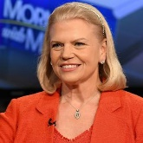

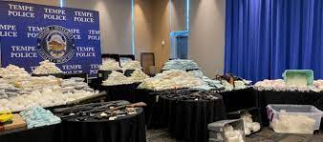
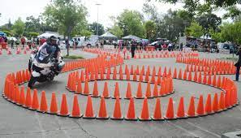
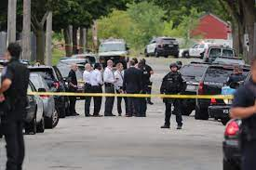
FBI
partner
development
DEA(herioin).likedin Christ tree IMPOT §422.6 hate crime(hass)
HOCME:LUX:COINTIE:INTERSTOW:HATEHOLE
FBI:WHITE:COLOAR
Gov.Schwaegger
TECHNOLOGY
Working at harldy davsion
Working at daelth row rocdord
Working at sons of ancy
J
10:35
POLCIE SIRENS
Consutatn $180/hr
Whole Day$
$1440 per consutaiotn
24-100 consutlatins
DL
10:38 §Public Disturbance: Jacks Teller Motocylce
[x]no
Guy drive mother cyin in circle
§Publi Distance
Farting around
Fucking around

Slide 3
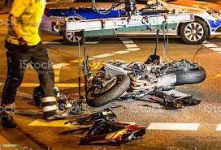
FBI
partner
development
DAVISION GENERAL AVIALIBIET (GA)
This is a wonder
fp[alce to work
Guy t driever lice harldy daivson, backup blond you fucked amy
25 motcyels. Ga
[x] no I ma her do my lcines. Ga.

Slide 4
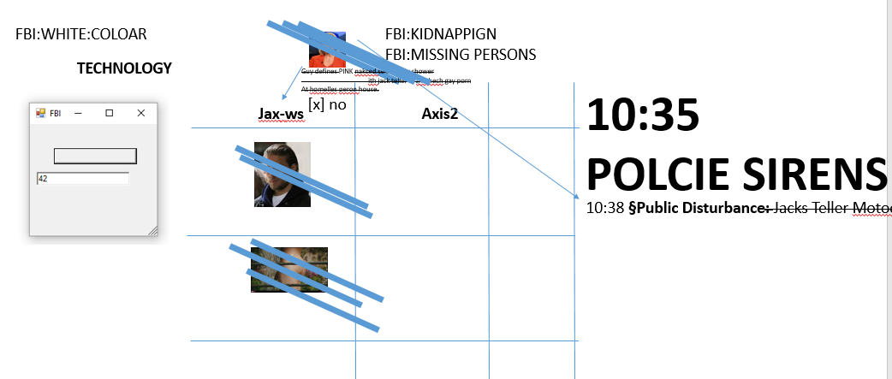
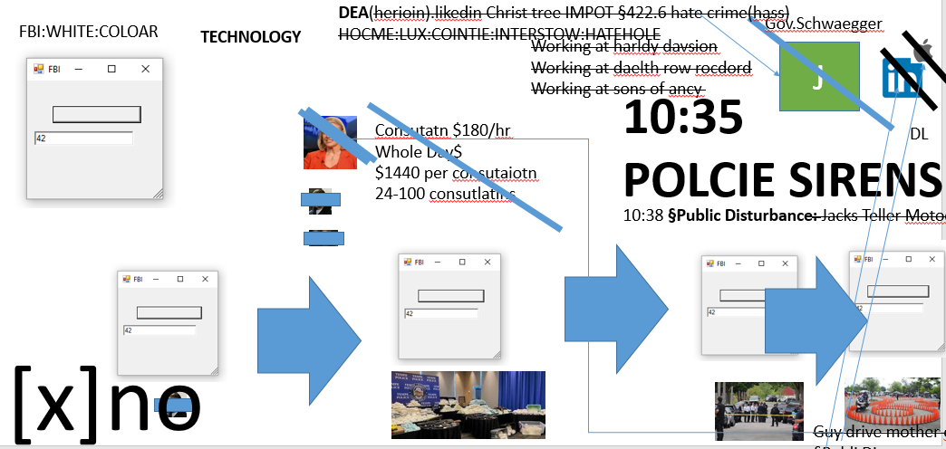
FBI
partner
development
And then?

Slide 5
FBI
partner
development
DAVISION GENERAL AVIALIBIET (GA)
This is a wonder
fp[alce to work
Guy t driever lice harldy daivson, backup blond you fucked amy
25 motcyels. Ga
[x] no I ma her do my lcines. Ga.

Slide 6
FBI
partner
development
10:35
POLCIE SIRENS
10:38 §Public Disturbance: Jacks Teller Motocylce

Slide 7
FBI
partner
development
10:35
POLCIE SIRENS
10:38 §Public Disturbance: Jacks Teller Motocylce
Max Plank Ec2 caltouraor
Montoring of devleopment
SCREENT: why don you just ge a job? Davidssno
Fort myers
guy: writes sexa and city and iam mrongi
at harly division in coptue rroom

Slide 8
FBI
partner
development
10:35
POLCIE SIRENS
10:38 §Public Disturbance: Jacks Teller Motocylce
Inteve facebook little box
Chinea asshsoems must put in little box

Slide 9
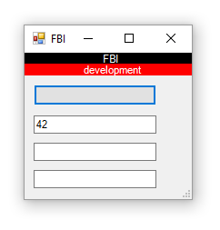
FBI
partner
development
10:35
POLCIE SIRENS
10:38 §Public Disturbance: Jacks Teller Motocylce
I flipped the boxes added console
Chinea asshsoems must put in little box

Slide 10
FBI
partner
development
10:35
POLCIE SIRENS
10:38 §Public Disturbance: Jacks Teller Motocylce
I flipped the boxes added console
Make box smaller
Chinea asshsoems must put in little box

